Slide 1
Designing iir Filters by linearizing the feedback coefficients
By:
Hambal Tella
Mohammmed Elrashidy
Ruwwad Alhejaili
Khalil Chikhaoui

Slide 2
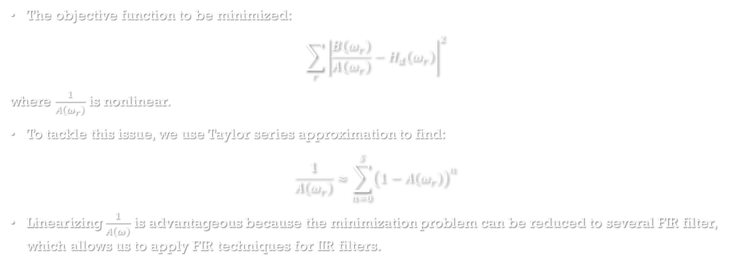
Derivation Steps
The objective function to be minimized:
$$\sum_{r}{{\left|\frac{B\left(ω_{r}\right)}{A\left(ω_{r}\right)}−H_{d}\left(ω_{r}\right)\right|}^{2}}$$
where $\frac{1}{A\left(ω_{r}\right)}$ is nonlinear.
To tackle this issue, we use Taylor series approximation to find:
$$\frac{1}{A\left(ω_{r}\right)}≈\sum_{n=0}^{S}{{\left(1−A\left(ω_{r}\right)\right)}^{n}}$$
Linearizing $\frac{1}{A\left(ω\right)}$ is advantageous because the minimization problem can be reduced to several FIR filter, which allows us to apply FIR techniques for IIR filters.

Slide 3
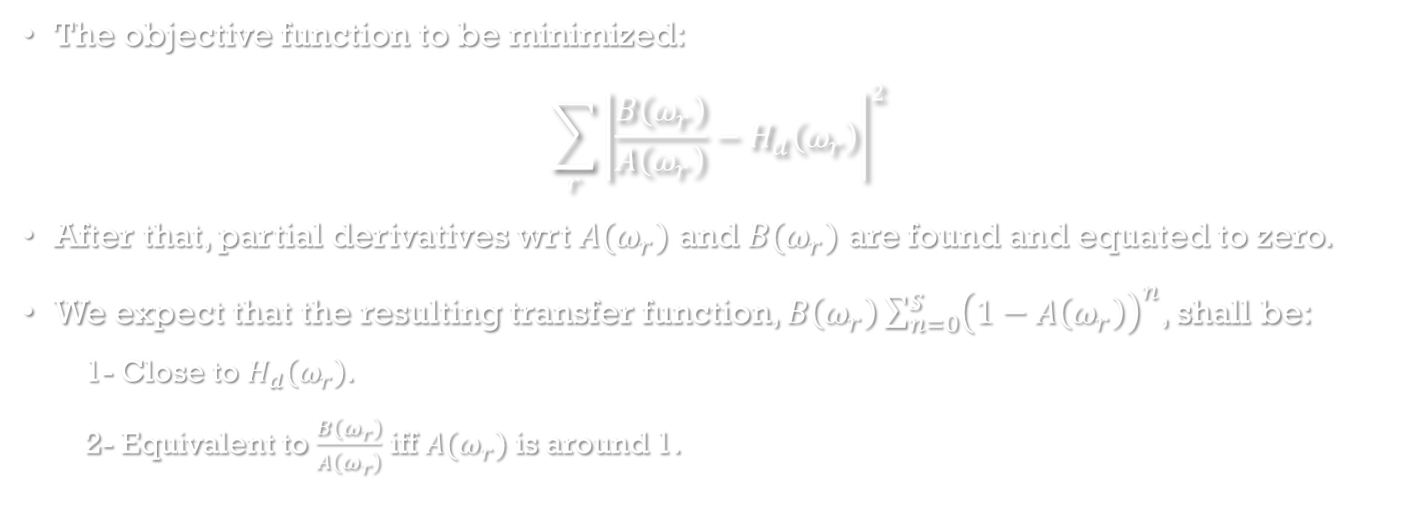
Derivation Steps
The objective function to be minimized:
$$\sum_{r}{{\left|\frac{B\left(ω_{r}\right)}{A\left(ω_{r}\right)}−H_{d}\left(ω_{r}\right)\right|}^{2}}$$
After that, partial derivatives wrt $A(ω_{r})$ and $B(ω_{r})$ are found and equated to zero.
We expect that the resulting transfer function, $B\left(ω_{r}\right)\sum_{n=0}^{S}{{\left(1−A\left(ω_{r}\right)\right)}^{n}}$, shall be:
1- Close to $H_{d}\left(ω_{r}\right)$.
2- Equivalent to $\frac{B\left(ω_{r}\right)}{A\left(ω_{r}\right)}$ iff $A(ω_{r})$ is around 1.

Slide 4
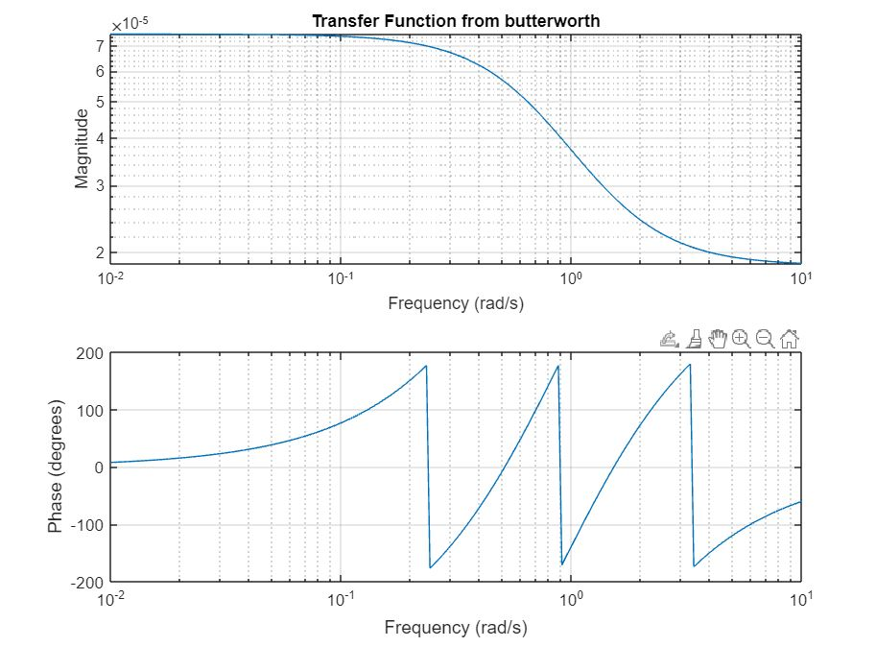
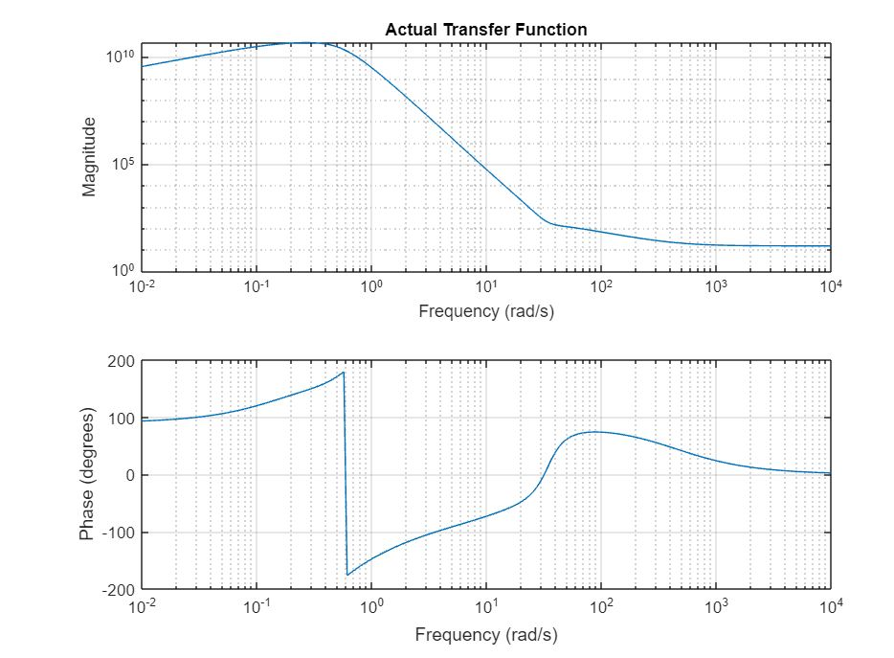
Results

Slide 5
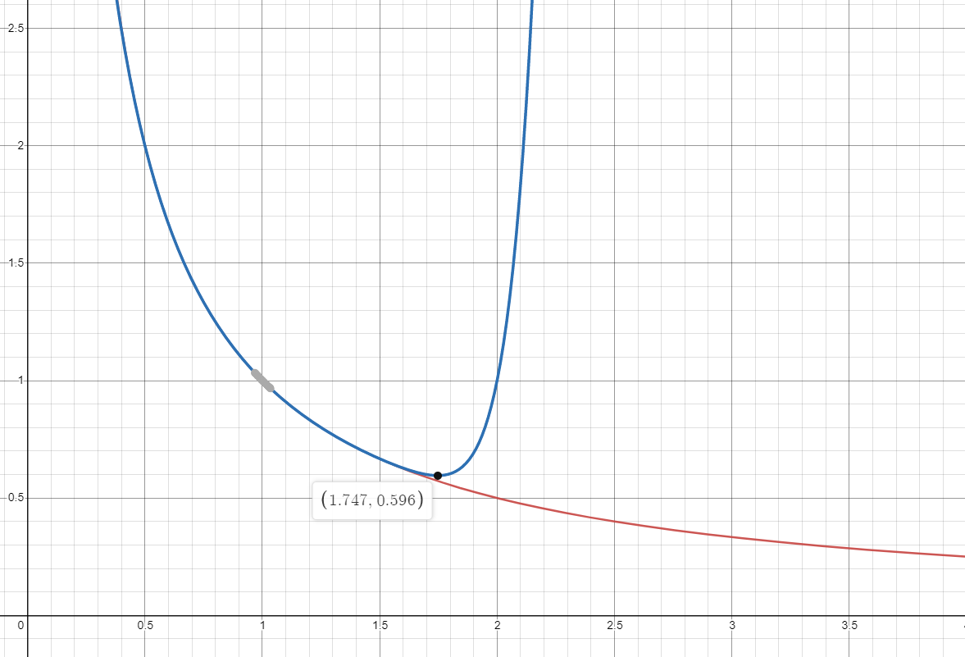
Results

